Slide 1
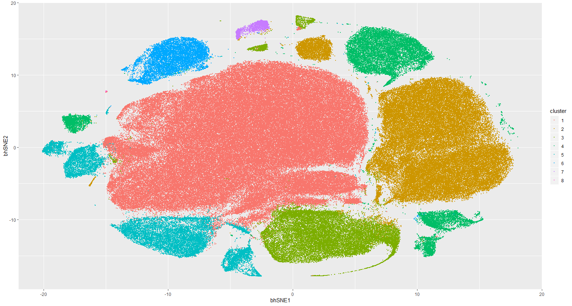
Notes:
ccRCC_652T_Tcells 8

Slide 2
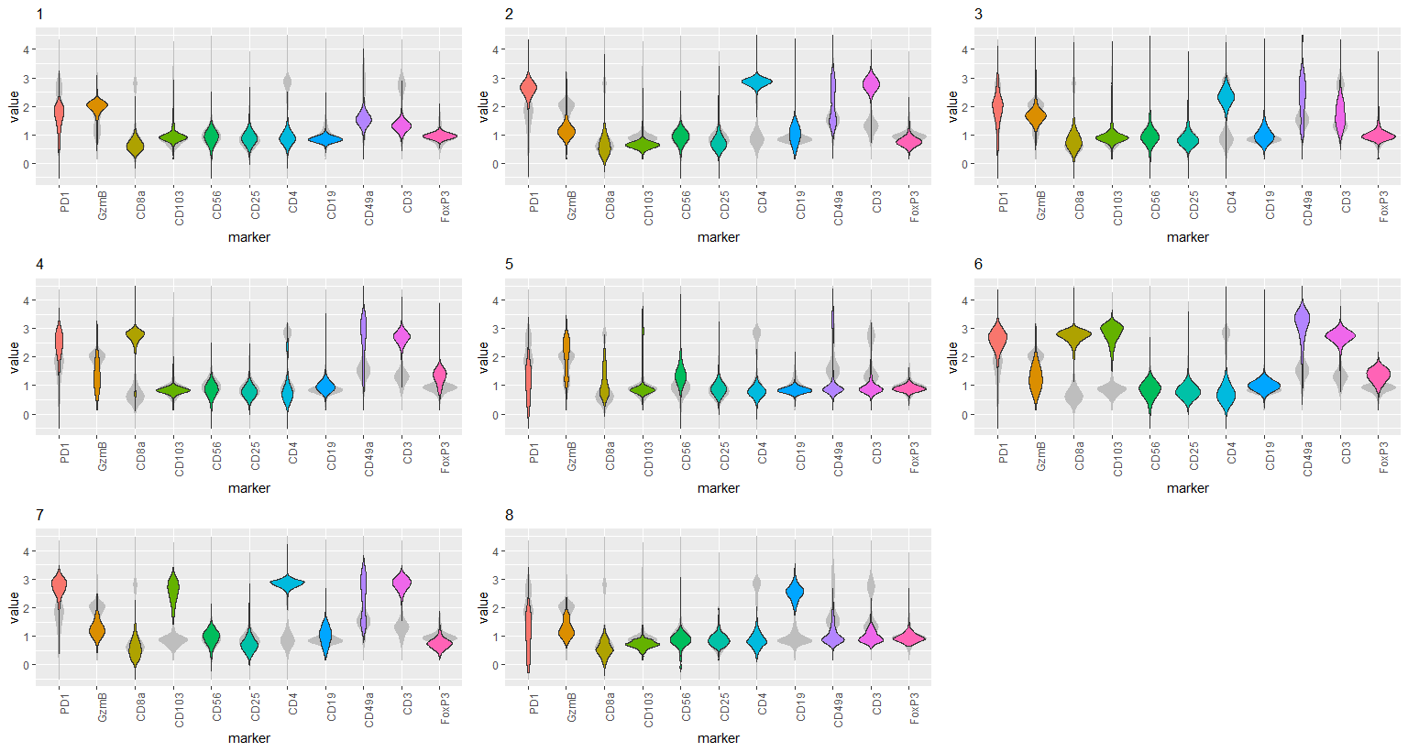
Notes:
ccRCC_652T_Tcells 8

Slide 3
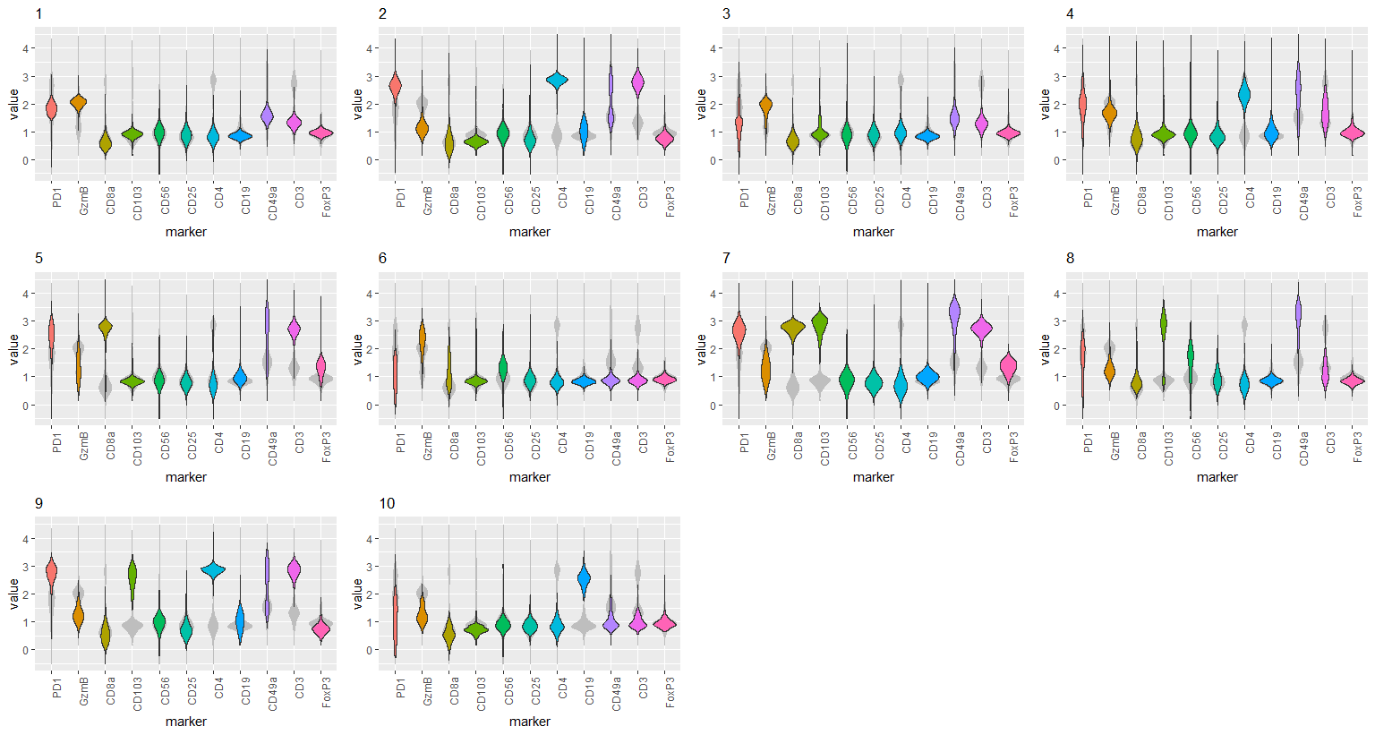
Notes:
ccRCC_652T_Tcells 10

Slide 4
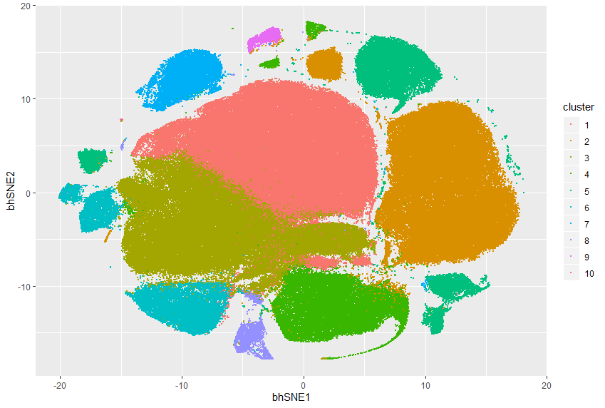
Notes:
ccRCC_652T_Tcells 10

